Slide 1
Last time: Problem-Solving
  Problem solving:
    Goal formulation
    Problem formulation (states, operators)
    Search for solution
  Problem formulation:
    Initial state
    ?
    ?
    ?
  Problem types:
    single state: accessible and deterministic environment
    multiple state: ?
    contingency: ?
    exploration: ?

Slide 2
Last time: Problem-Solving
  Problem solving:
    Goal formulation
    Problem formulation (states, operators)
    Search for solution
  Problem formulation:
    Initial state
    Operators
    Goal test
    Path cost
  Problem types:
    single state: accessible and deterministic environment
    multiple state: ?
    contingency: ?
    exploration: ?

Slide 3
Last time: Problem-Solving
  Problem solving:
    Goal formulation
    Problem formulation (states, operators)
    Search for solution
  Problem formulation:
    Initial state
    Operators
    Goal test
    Path cost
  Problem types:
    single state: accessible and deterministic environment
    multiple state: inaccessible and deterministic environment
    contingency: inaccessible and nondeterministic environment
    exploration: unknown state-space

Slide 4
Last time: Finding a solution
Solution: is ???
Basic idea: offline, systematic exploration of simulated state-space by generating successors of explored states (expanding)
Function General-Search(problem, strategy) returns a solution, or failure
initialize the search tree using the initial state problem
loop do
if there are no candidates for expansion then return failure
choose a leaf node for expansion according to strategy
if the node contains a goal state then return the corresponding solution
else expand the node and add resulting nodes to the search tree
end

Slide 5
Last time: Finding a solution
Solution: is a sequence of operators that bring you from current state to the goal state.
Basic idea: offline, systematic exploration of simulated state-space by generating successors of explored states (expanding).
Function General-Search(problem, strategy) returns a solution, or failure
initialize the search tree using the initial state problem
loop do
if there are no candidates for expansion then return failure
choose a leaf node for expansion according to strategy
if the node contains a goal state then return the corresponding solution
else expand the node and add resulting nodes to the search tree
end
Strategy: The search strategy is determined by ???

Slide 6
Last time: Finding a solution
Solution: is a sequence of operators that bring you from current state to the goal state
Basic idea: offline, systematic exploration of simulated state-space by generating successors of explored states (expanding)
Function General-Search(problem, strategy) returns a solution, or failure
initialize the search tree using the initial state problem
loop do
if there are no candidates for expansion then return failure
choose a leaf node for expansion according to strategy
if the node contains a goal state then return the corresponding solution
else expand the node and add resulting nodes to the search tree
end
Strategy: The search strategy is determined by the order in which the nodes are expanded.

Slide 7
A Clean Robust Algorithm
Function UniformCost-Search(problem, Queuing-Fn) returns a solution, or failure
open ← make-queue(make-node(initial-state[problem]))
closed ← [empty]
loop do
if open is empty then return failure
currnode ← Remove-Front(open)
if Goal-Test[problem] applied to State(currnode) then return currnode
children ← Expand(currnode, Operators[problem])
while children not empty
[… see next slide …]
end
closed ← Insert(closed, currnode)
open ← Sort-By-PathCost(open)
end

Slide 8
A Clean Robust Algorithm
[… see previous slide …]
children ← Expand(currnode, Operators[problem])
while children not empty
child ← Remove-Front(children)
if no node in open or closed has child’s state
open ← Queuing-Fn(open, child)
else if there exists node in open that has child’s state
if PathCost(child) < PathCost(node)
open ← Delete-Node(open, node)
open ← Queuing-Fn(open, child)
else if there exists node in closed that has child’s state
if PathCost(child) < PathCost(node)
closed ← Delete-Node(closed, node)
open ← Queuing-Fn(open, child)
end
[… see previous slide …]

Slide 9
Last time: search strategies
Uninformed: Use only information available in the problem formulation
  Breadth-first
  Uniform-cost
  Depth-first
  Depth-limited
  Iterative deepening
Informed: Use heuristics to guide the search
  Best first
  A*

Slide 10
Evaluation of search strategies
Search algorithms are commonly evaluated according to the following four criteria:
  Completeness: does it always find a solution if one exists?
  Time complexity: how long does it take as a function of number of nodes?
  Space complexity: how much memory does it require?
  Optimality: does it guarantee the least-cost solution?
Time and space complexity are measured in terms of:
  b – max branching factor of the search tree
  d – depth of the least-cost solution
  m – max depth of the search tree (may be infinity)

Slide 11
Last time: uninformed search strategies
Uninformed search:
Use only information available in the problem formulation
  Breadth-first
  Uniform-cost
  Depth-first
  Depth-limited
  Iterative deepening

Slide 12
This time: informed search
Informed search:
Use heuristics to guide the search
  Best first
  A*
  Heuristics
  Hill-climbing
  Simulated annealing

Slide 13
Best-first search
Idea:
use an evaluation function for each node; estimate of “desirability”
expand most desirable unexpanded node.
Implementation:
QueueingFn = insert successors in decreasing order of desirability
Special cases:
greedy search
A* search

Slide 14
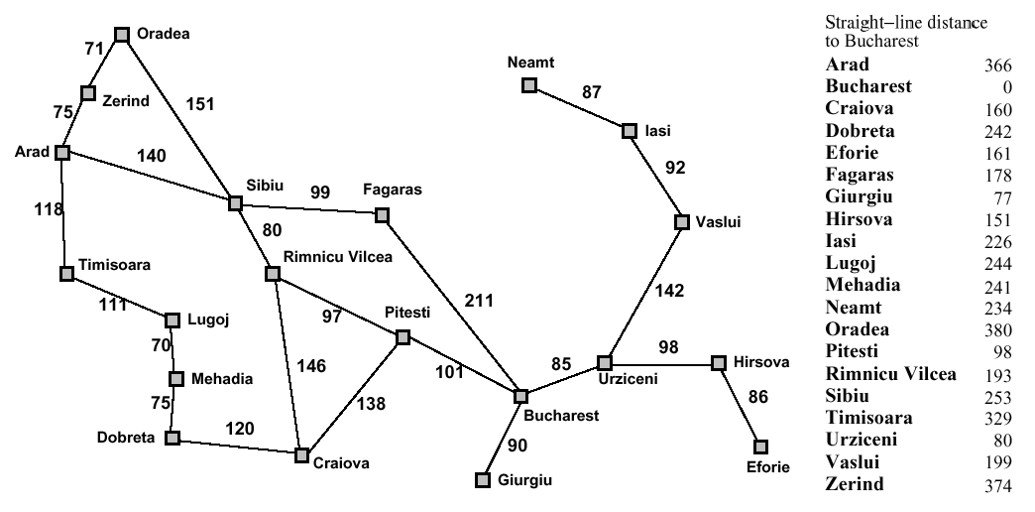
Romania with step costs in km

Slide 15
Greedy search
Estimation function:
h(n) = estimate of cost from n to goal (heuristic)
For example:
h_{SLD}(n) = straight-line distance from n to Bucharest
Greedy search expands first the node that appears to be closest to the goal, according to h(n).

Slide 16
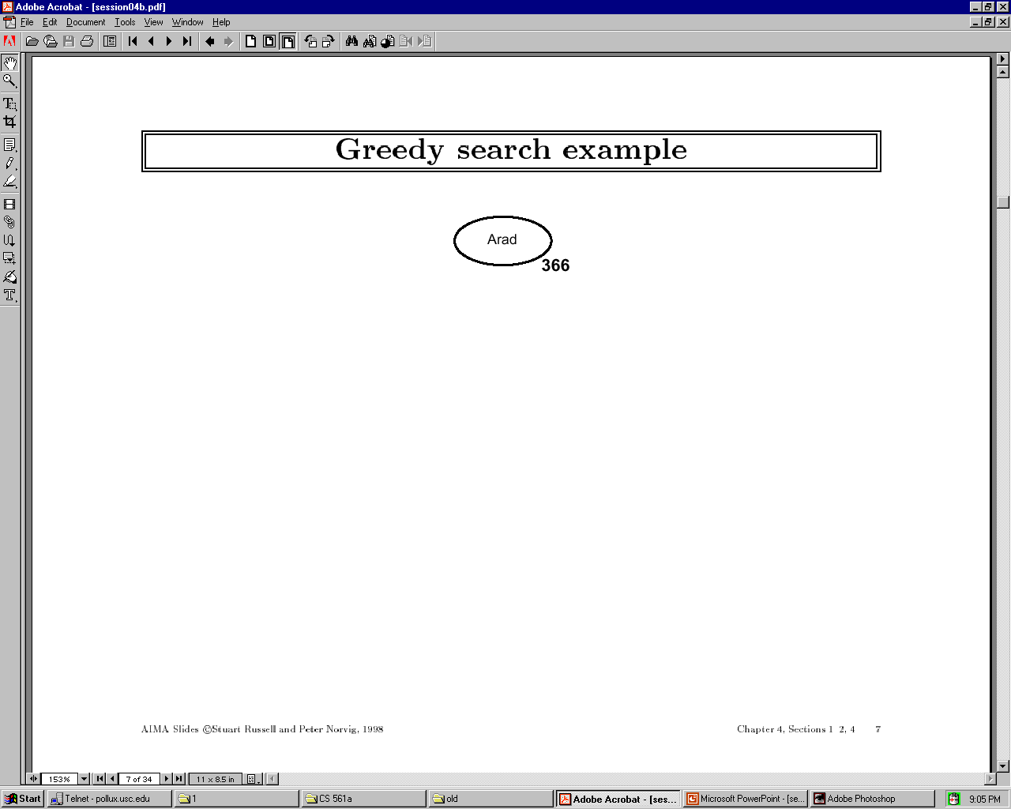

Slide 17
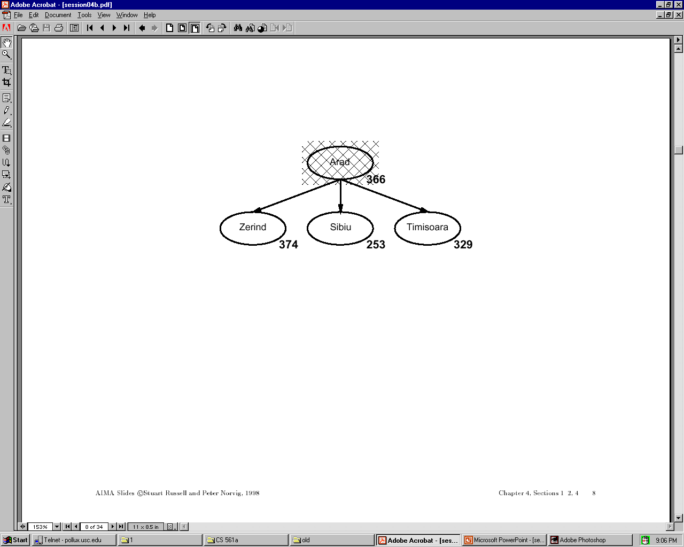

Slide 18
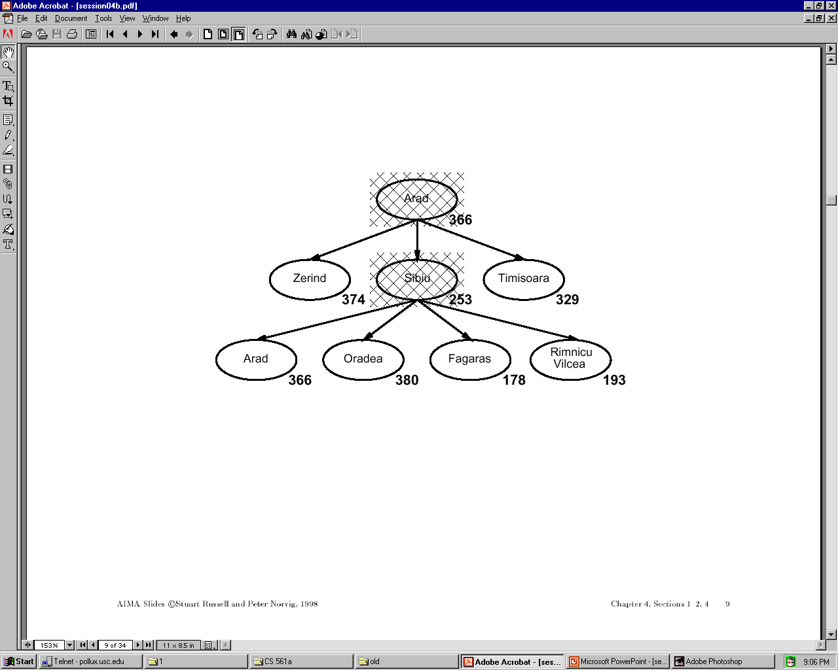

Slide 19
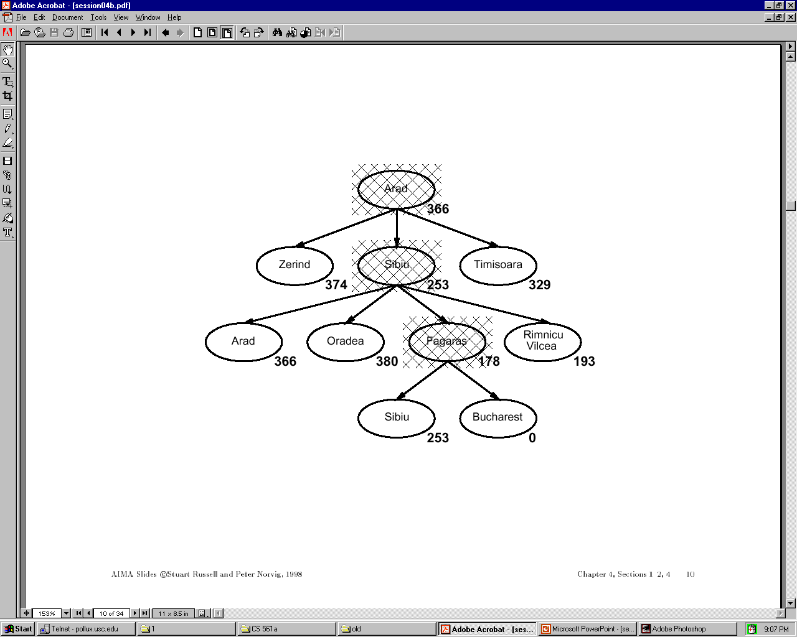

Slide 20
Properties of Greedy Search
Complete?
Time?
Space?
Optimal?

Slide 21
Properties of Greedy Search
Complete? No – can get stuck in loops
e.g., Iasi > Neamt > Iasi > Neamt > …
Complete in finite space with repeated-state checking.
Time? O(b^m) but a good heuristic can give
dramatic improvement
Space? O(b^m) – keeps all nodes in memory
Optimal? No.

Slide 22
A* search
Idea: avoid expanding paths that are already expensive
evaluation function: f(n) = g(n) + h(n) with:
g(n) – cost so far to reach n
h(n) – estimated cost to goal from n
f(n) – estimated total cost of path through n to goal
A* search uses an admissible heuristic, that is,
h(n) ≤ h*(n) where h*(n) is the true cost from n.
For example: h_{SLD}(n) never overestimates actual road distance.
Theorem: A* search is optimal

Slide 23
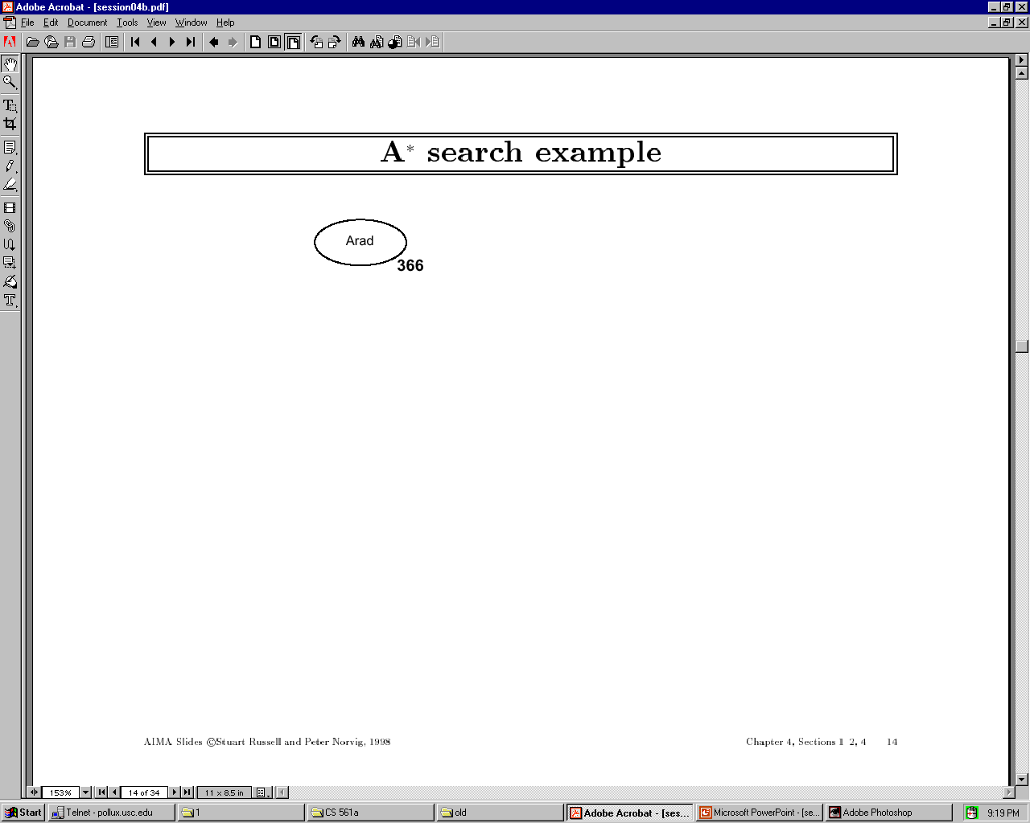

Slide 24
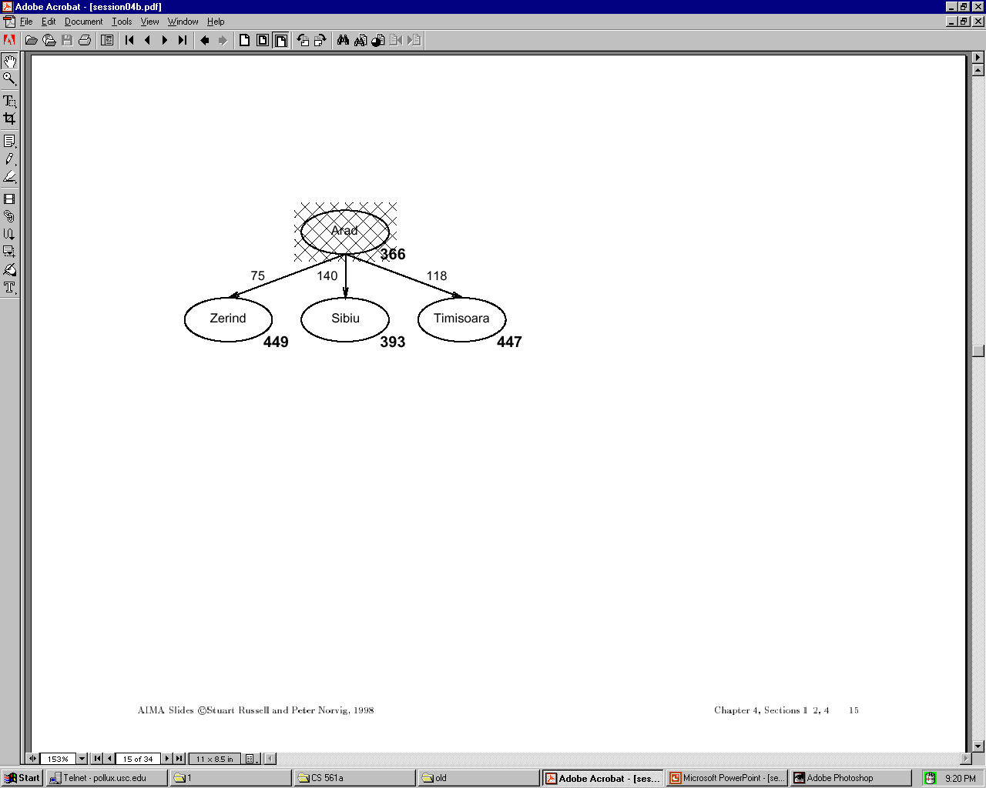

Slide 25
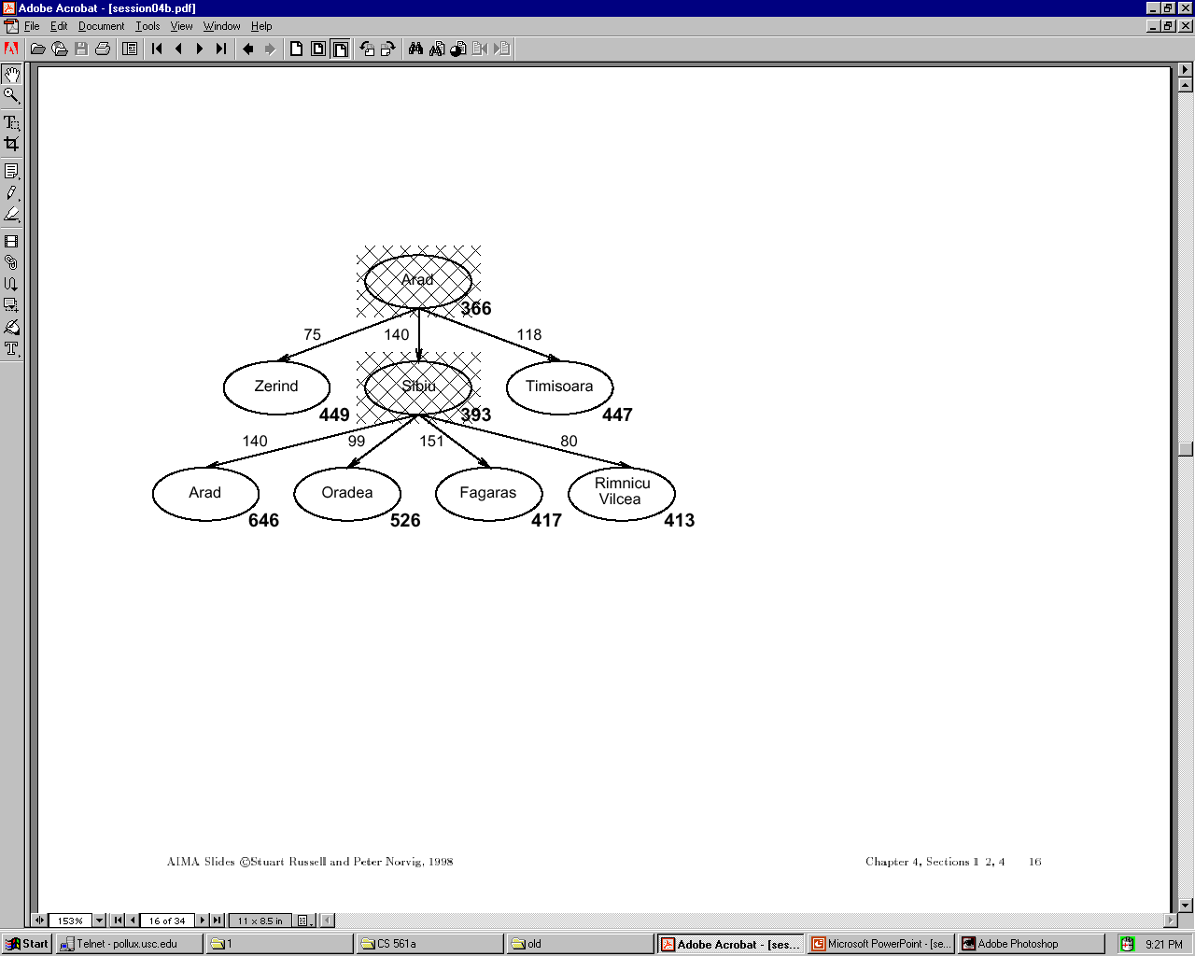

Slide 26
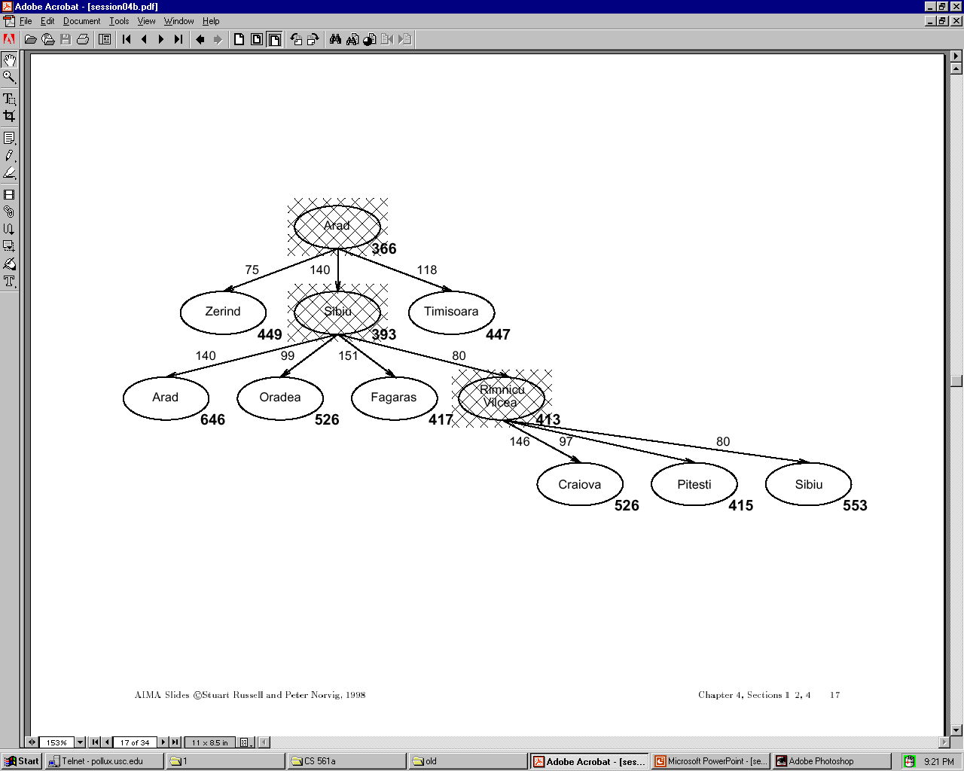

Slide 27
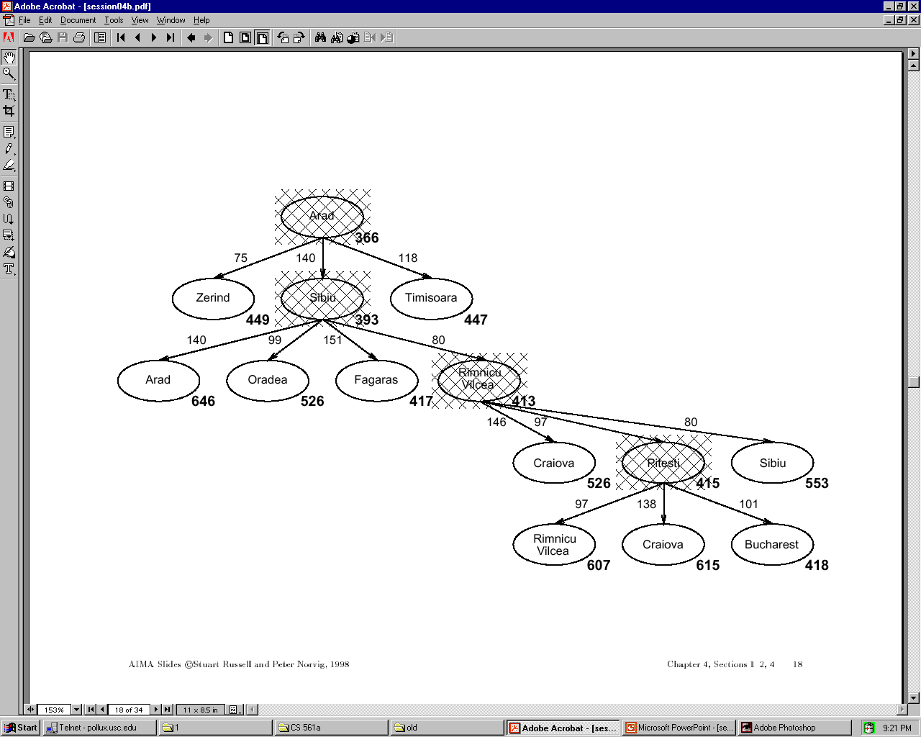

Slide 28
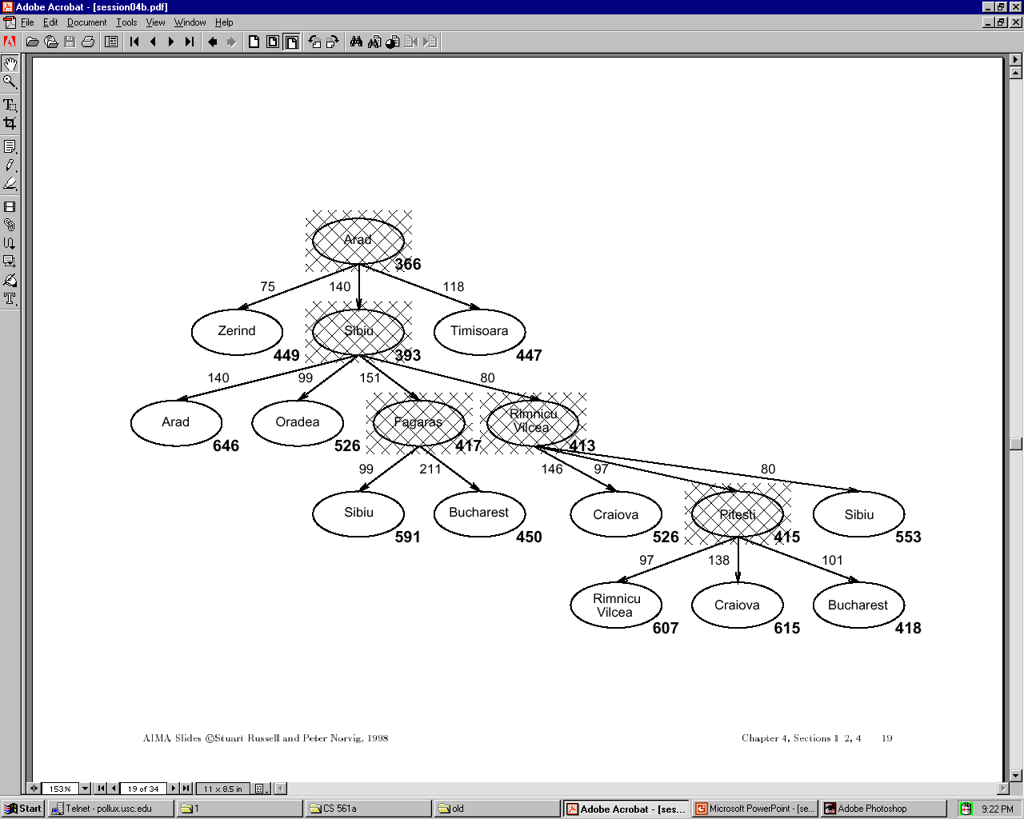

Slide 29
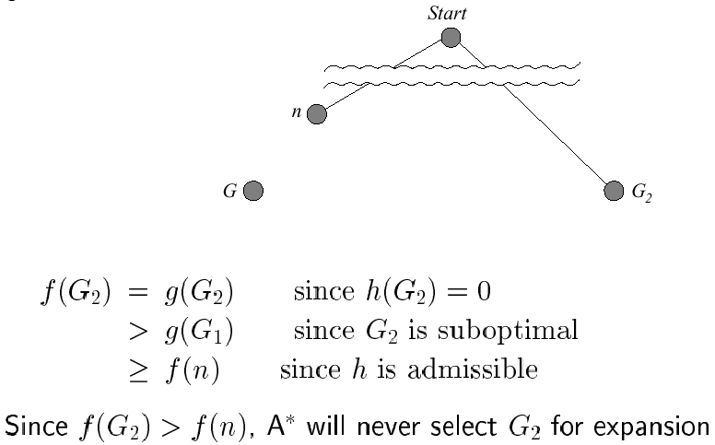
Optimality of A* (standard proof)
Suppose some suboptimal goal G₂ has been generated and is in the queue. Let n be an unexpanded node on a shortest path to an optimal goal G₁.

Slide 30
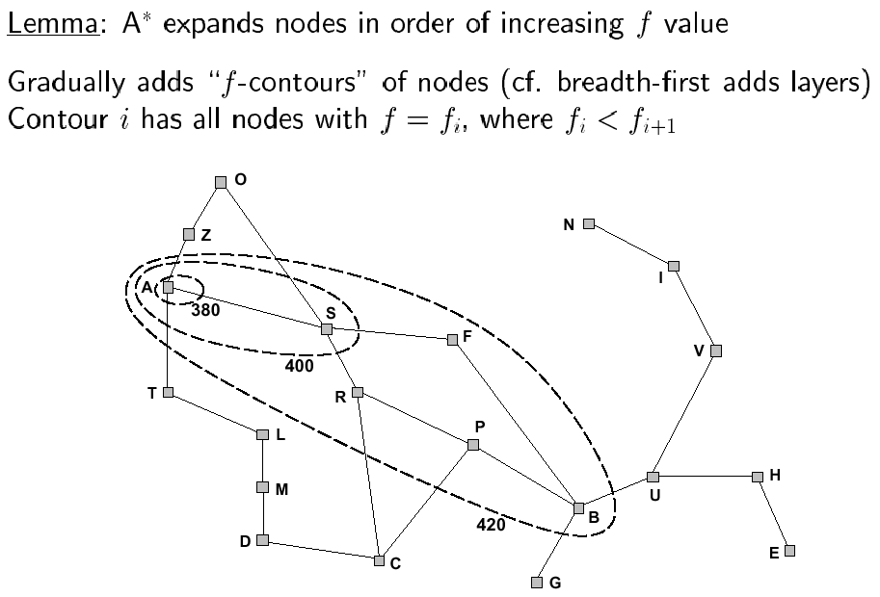
Optimality of A* (more useful proof)

Slide 31
Properties of A*
Complete?
Time?
Space?
Optimal?

Slide 32
Properties of A*
Complete? Yes, unless infinitely many nodes with f ≤ f(G)
Time? Exponential in [(relative error in h) x (length of solution)]
Space? Keeps all nodes in memory
Optimal? Yes – cannot expand f_{i+1} until f_{i} is finished

Slide 33
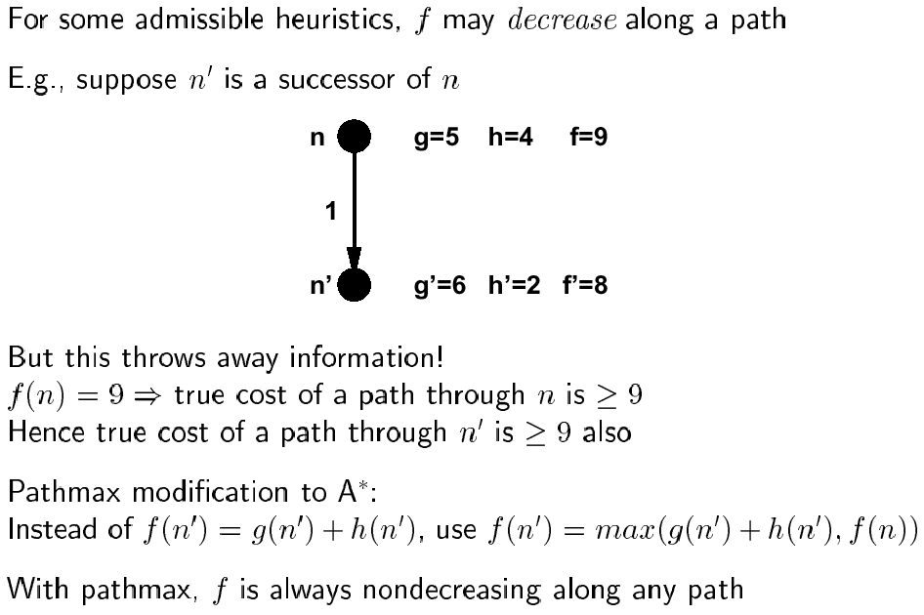
Proof of lemma: pathmax

Slide 34
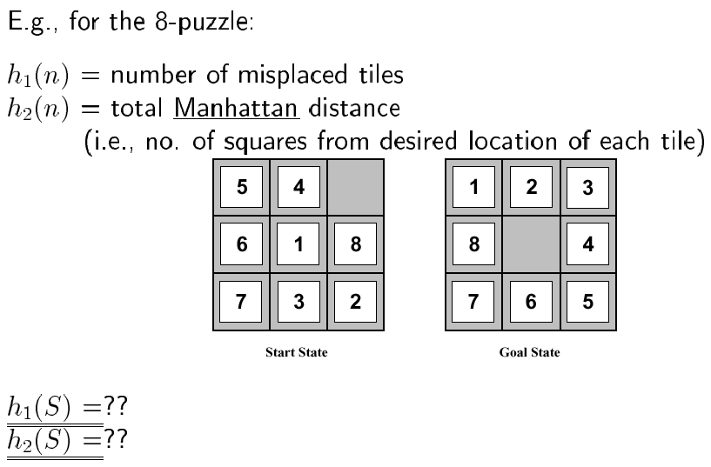
Admissible heuristics

Slide 35
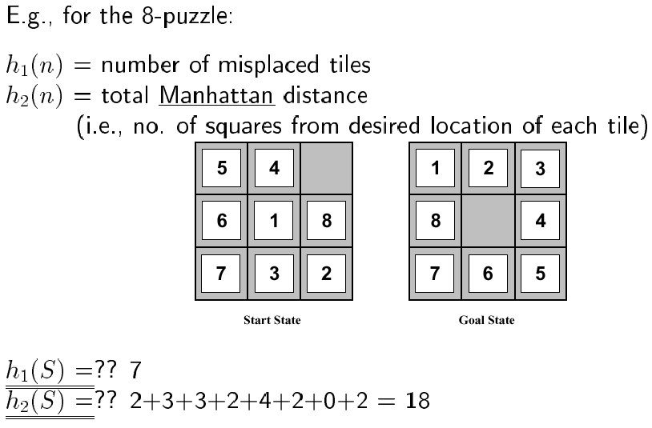
Admissible heuristics

Slide 36
Relaxed Problem
Admissible heuristics can be derived from the exact solution cost of a relaxed version of the problem.
If the rules of the 8-puzzle are relaxed so that a tile can move anywhere, then h₁(n) gives the shortest solution.
If the rules are relaxed so that a tile can move to any adjacent square, then h₂(n) gives the shortest solution.

Slide 37
Next time
Iterative improvement
Hill climbing
Simulated annealing

